Slide 1


Transmission Media

Slide 2
A transmission medium :
carry information from source to a destination.
Example:
Medium for two people having a dinner conversation is the air.

Slide 3
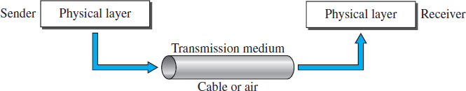

Slide 4
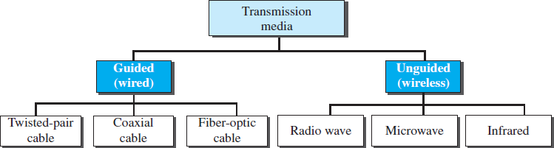
Classes of transmission media

Slide 5
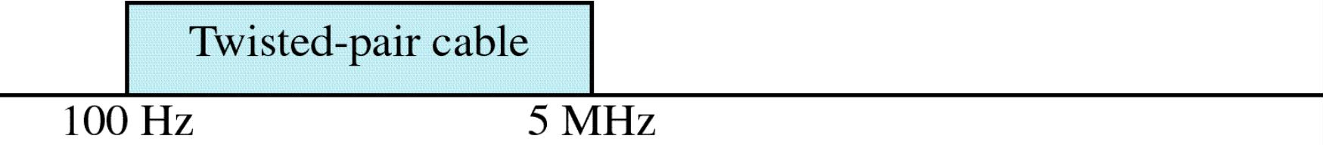
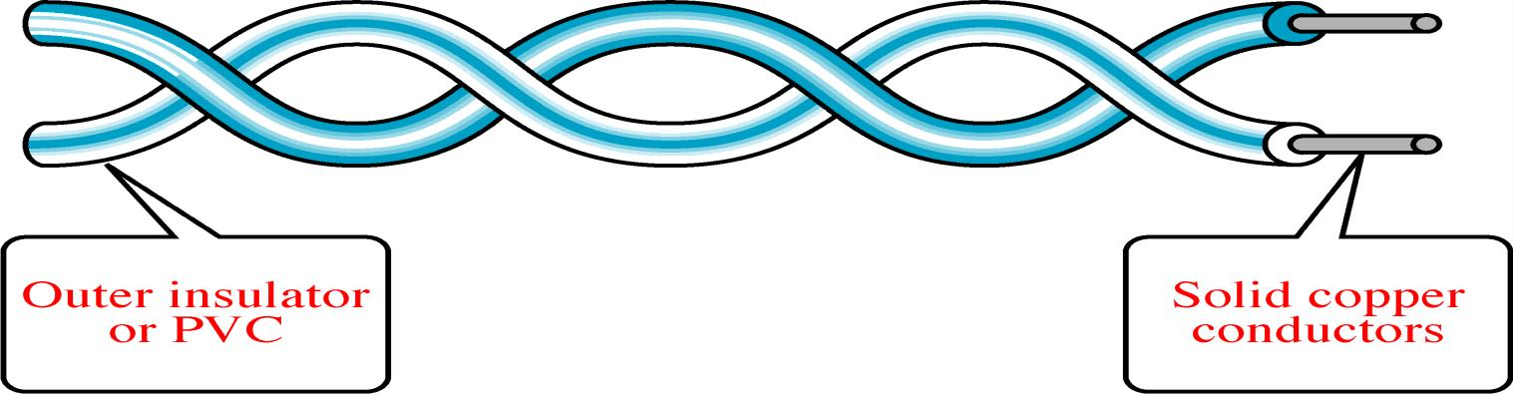
Twisted-Pair Cable
Notes:
Twisted-pair and coaxial cable use metallic (copper) conductors that accept and transport signals in the form of electric current.
Optical fiber is a cable that accepts and transports signals in the form of light.

Slide 6
Twisted-Pair Cable Twisted Pair and Coax use metallic(Copper) conductors that: Accept the signals in the form of Electrical Current. Transport the signals in the form of Electrical Current

Slide 7
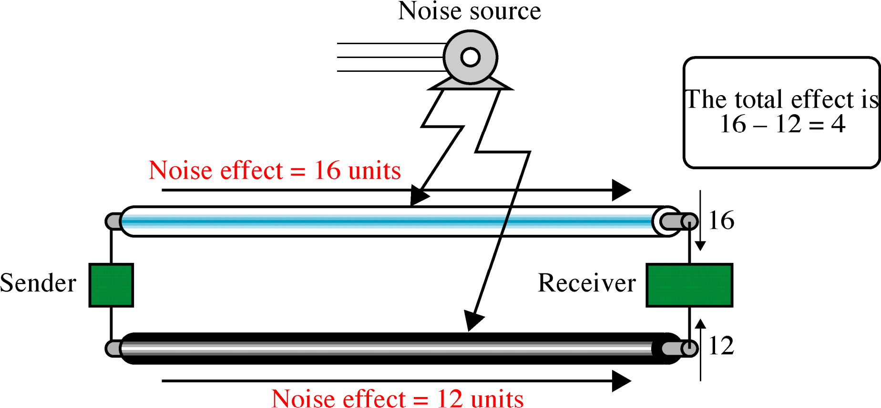
Effect of Noise on Parallel Lines
Notes:
If the two wires are parallel, the effect of these unwanted signals is not the same in
both wires because they are at different locations relative to the noise or crosstalk sources (e.g., one is closer and the other is farther). This results in a difference at the receiver.

Slide 8
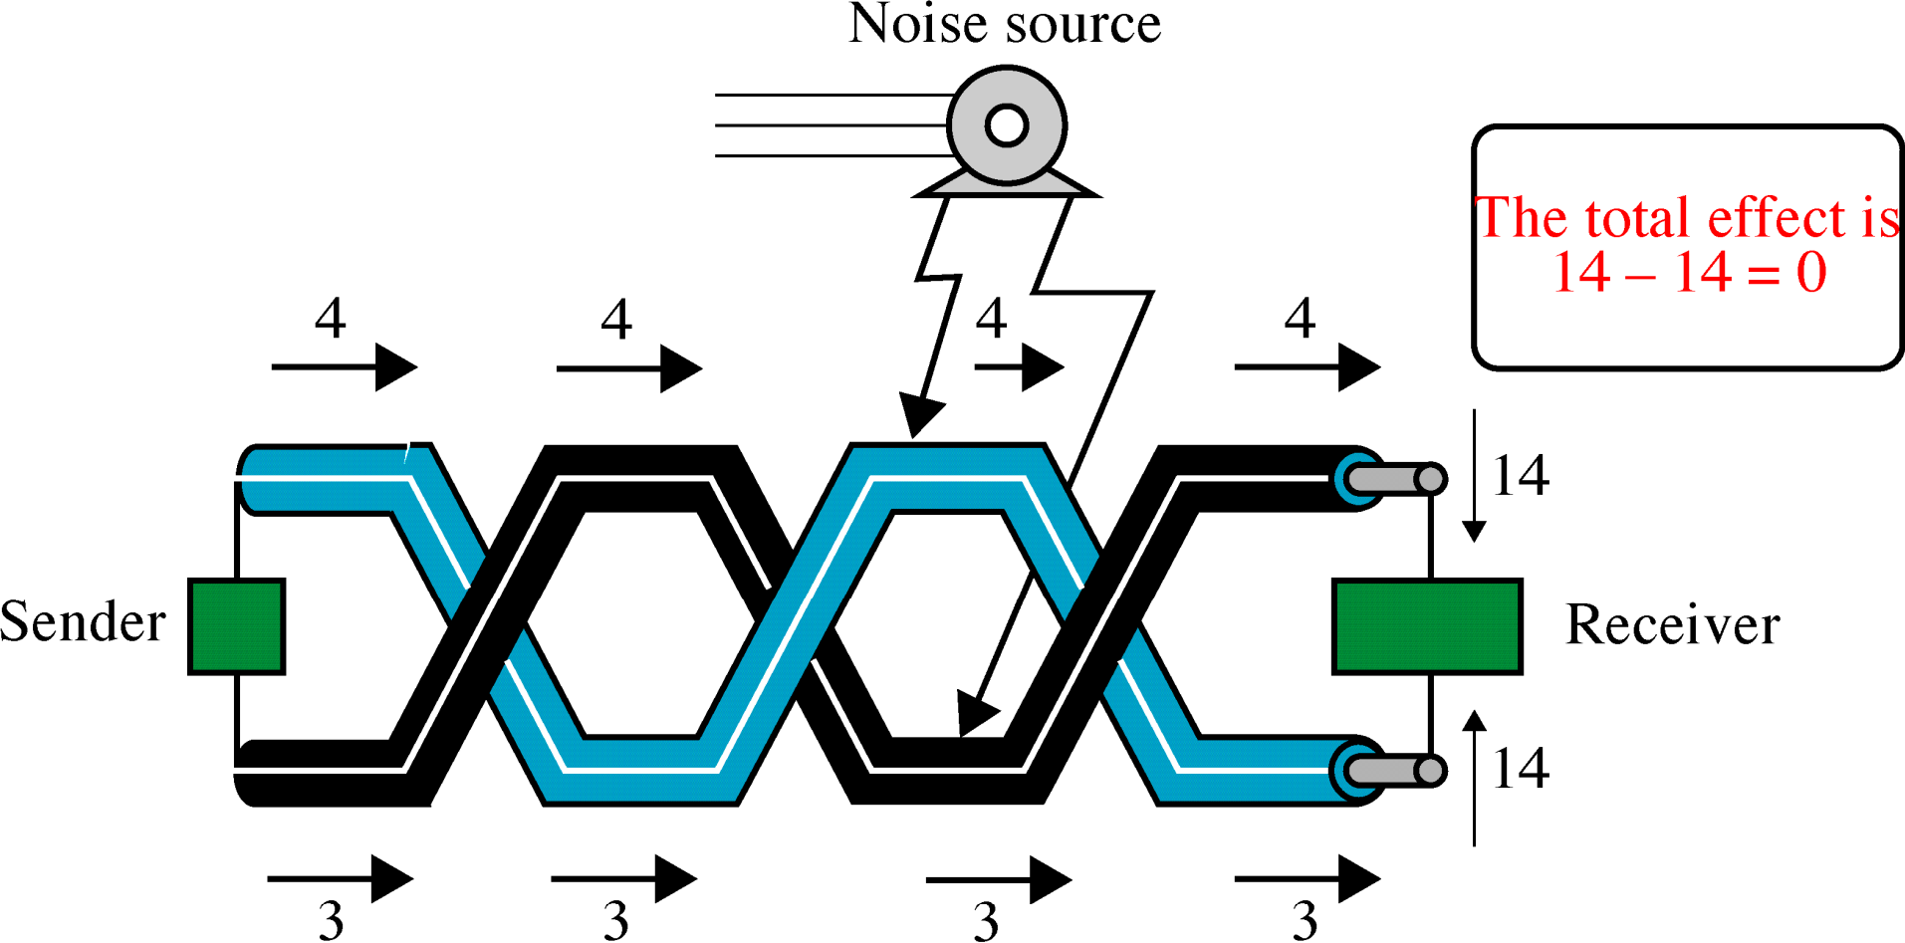
Noise on Twisted-Pair Lines

Slide 9
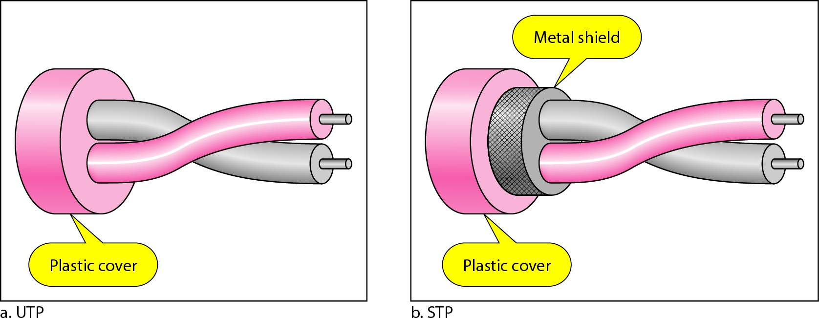
UTP and STP cables

Slide 10
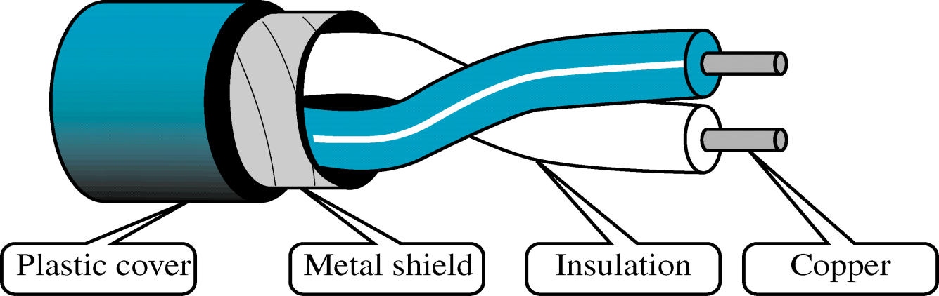
Shielded Twisted-Pair Cable
Metal prevents the penetration of electromagnetic noise.
Eliminate the phenomenon , called CROSSTALK

Slide 11
Advantages :
Cheaper
Less susceptible to electrical interference
In turn are less likely to cause interference themselves.
4. Because it is electrically "cleaner":
STP wire can carry data at a faster speed.
7.11
Notes:
Less susceptible to electrical interference caused by nearby equipment or wires.

Slide 12
Disadvantages :
STP wire :
Physically larger and more expensive than twisted pair wire.

Slide 13
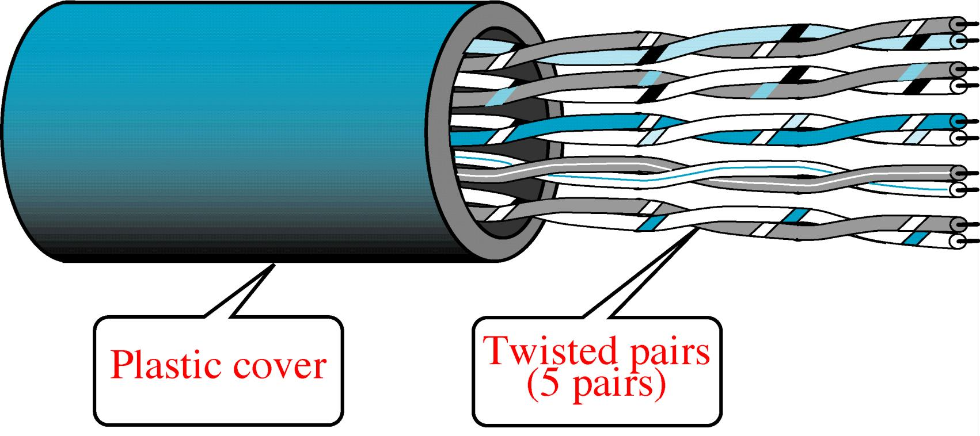
Unshielded Twisted-Pair Cable
Notes:
The most common UTP connector is RJ45 (RJ stands for registered jack), The RJ45 is a keyed connector, meaning the connector can be inserted in
only one way.
Electronic Industries Association (EIA) has developed standards to classify unshielded twisted-pair cable into seven categories. Categories are determined by cable
quality, with 1 as the lowest and 7 as the highest.

Slide 14

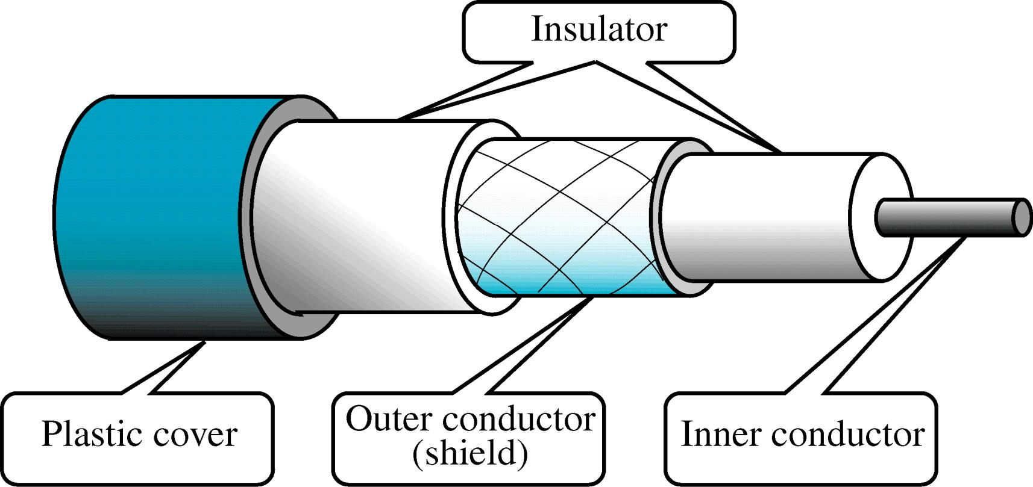
Coaxial Cable

Slide 15
High bandwidth
Excellent noise immunity.
The bandwidth possible depends on:
Cable quality and length.
Used within the telephone system, cable television and MAN
Now replaced by fiber optics on long distance routes.

Slide 16
Optical Fiber Cable
Optical Fiber is a glass or plastic cable
Accept and transport the signals in the form of Light.

Slide 17
Optical Fiber Cable
Advantages:
Noise Resistance
Less Signal Attenuation
Higher BW
Disadvantages:
Cost
Installation/Maintenance
Fragility(Broken Wire)

Slide 18
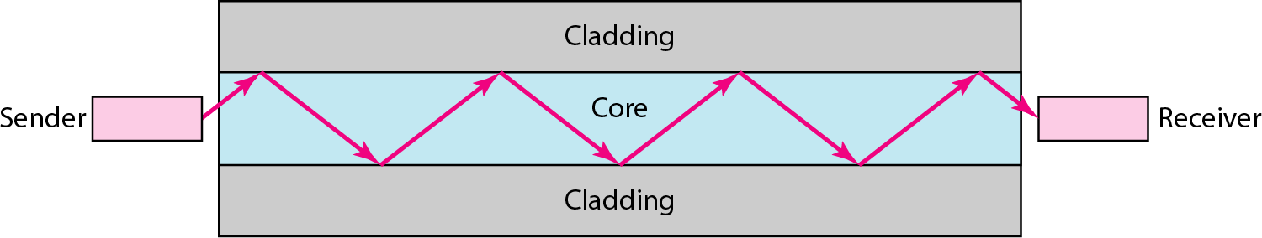
Optical fiber

Slide 19

UNGUIDED MEDIA: WIRELESS
Transport ElectroMagnetic Waves without Physical
Conductor.
2. This is often referred as Wireless Communication.
Notes:
Transport ElectroMagnetic Waves without Physical Conductor.
This is often referred as Wireless Communication.

Slide 20
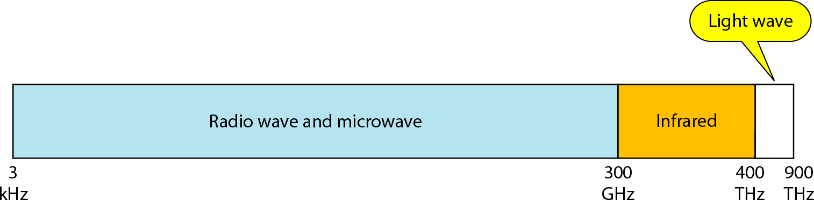
Electromagnetic spectrum for wireless communication

Slide 21
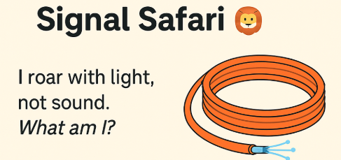
Game 1: Signal Safari 🦁
I roar in silence, travel in glass, hate the dark, and fear the twisty turns. Who am I?
Guess the transmission media!
A. Optical Fiber
B. Coaxial Cable
C. Twisted Pair
D. Radio Wave
Notes:
Correct Answer: A. Optical Fiber
Justification:
It uses light to transmit signals, needs clean straight paths, and is sensitive to bends and breaks.

Slide 22
Propagation Methods
Ground Propagation
Sky Propagation
Line-of-Sight Propagation
7.22

Slide 23
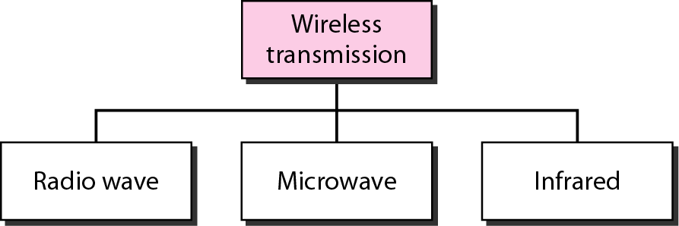
Wireless transmission waves

Slide 24
1. Used for multicast communications: Such as radio and television. 2. They can penetrate through walls. 3. Use Omni directional antennas
Radio Waves
Notes:
Radio waves, particularly those waves that propagate in the sky mode, can travel long distances.

Slide 25
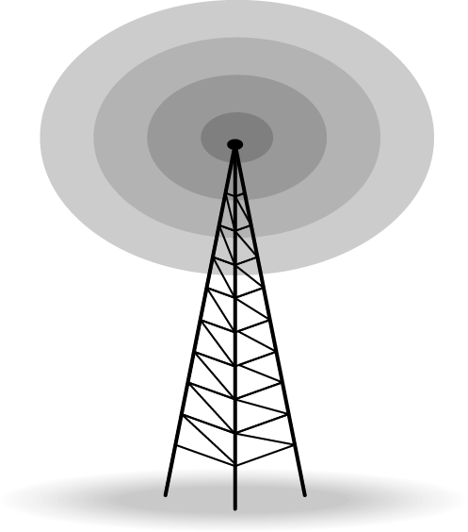
Omnidirectional antenna

Slide 26
Microwaves
1. Used for unicast communication:
As cellular telephones and wireless LANs.
Higher frequency ranges cannot penetrate walls.
3. Use directional antennas
point to point line of sight communications.

Slide 27
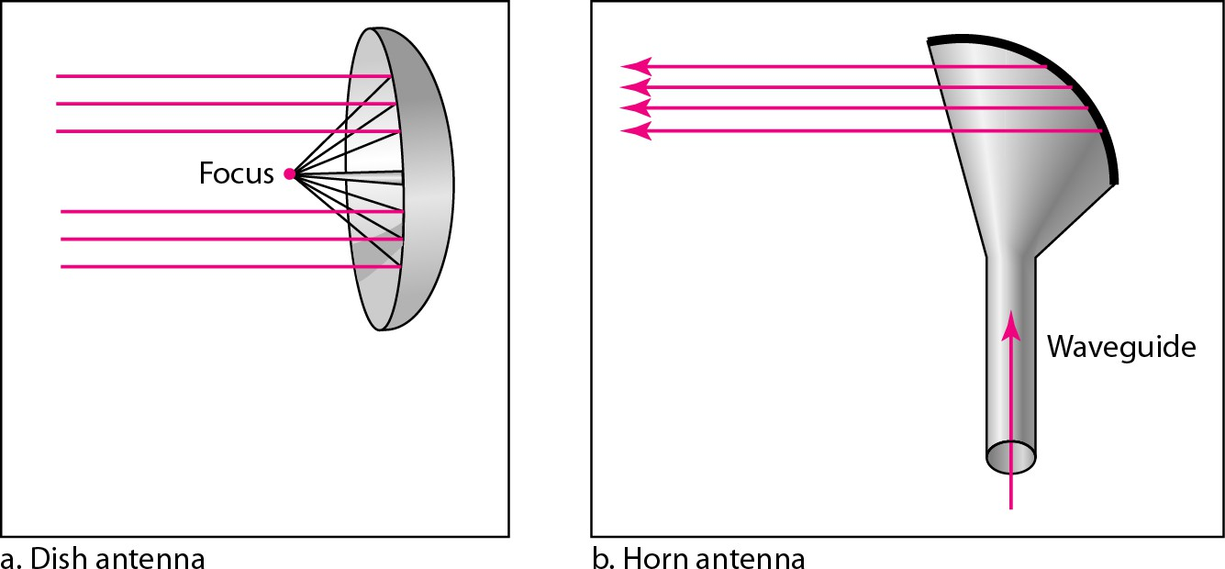
Unidirectional antennas
Notes:
Microwaves are unidirectional. When an antenna transmits microwaves, they can be narrowly focused. This means that the sending and receiving antennas need to be aligned.

Slide 28
Infrared signals:
1. Can be used for short- range communication in a closed area.
2. Uses line-of-sight propagation

Slide 29
Transmission Impairment
Signal transmit through medium that are not perfect.
This imperfection cause signal impairment.
What is sent is not received.

Slide 30
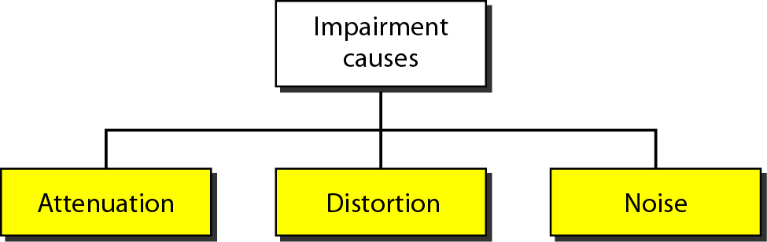
Causes of impairment

Slide 31
Attenuation
Means loss of energy -> weaker signal
When a signal travels through a medium:
Loses energy overcoming the resistance of the medium
Some of the electrical energy in the signal is converted to heat

Slide 32
Attenuation
Amplifiers :
Compensate for loss of energy by amplifying the signal.

Slide 33
Measurement of Attenuation
To show the loss or gain of energy the unit “decibel” is used.
dB = 10log₁₀P₂/P₁ P₁ - input signal P₂ - output signal

Slide 34
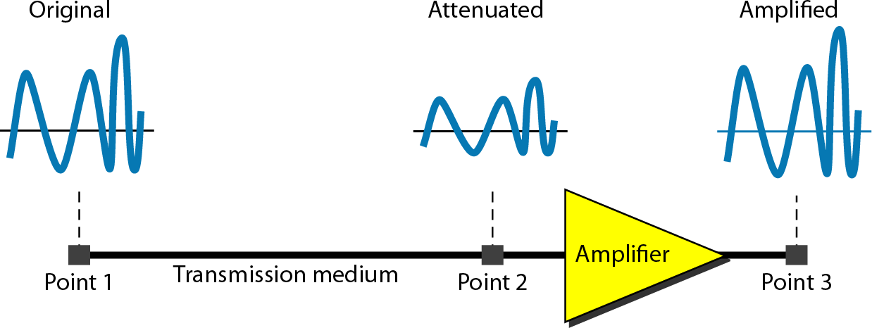
Attenuation

Slide 35





Example 3.27
A signal travels through an amplifier, and its power is increased 10 times. This means that P₂ = 10P₁ . In this case, the amplification (gain of power) can be calculated as

Slide 36
Distortion
Signal changes its form or shape
Distortion occurs in composite signals
Each frequency component has:
own propagation speed traveling through a medium.

Slide 37
Distortion
Different components therefore:
Arrive with different delays at the receiver.
Signals have different phases at:
The receiver than they did at the source.

Slide 38
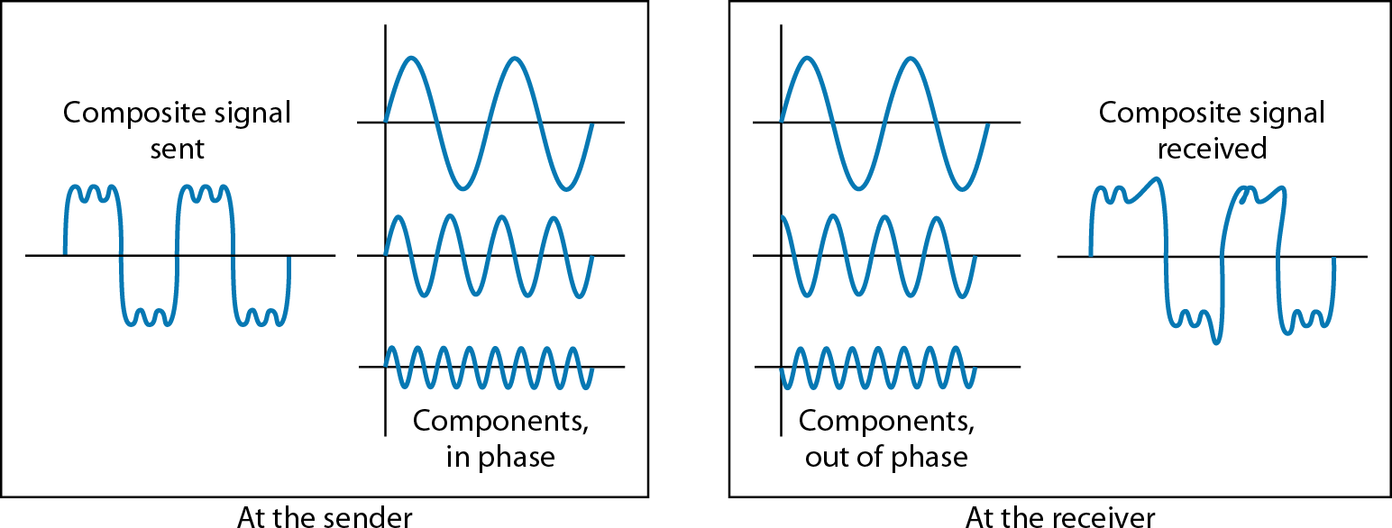
Distortion

Slide 39
Noise
There are different types of noise
Thermal –
Random noise of electrons in the wire creates an extra signal
Crosstalk -
Same as Thermal but between two wires.

Slide 40
Noise
There are different types of noise
Impulse -
Spikes that result from power lines, lightening, etc.

Slide 41
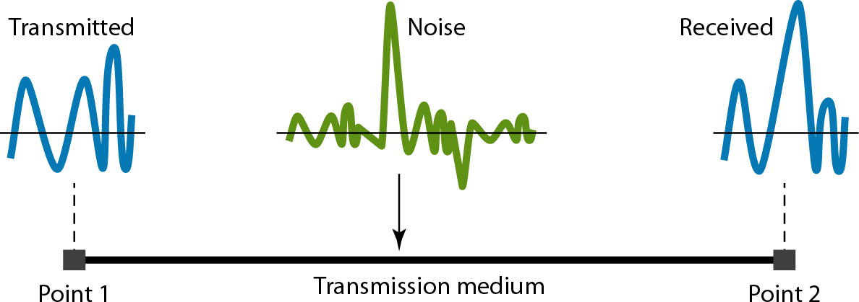
Noise

Slide 42
Game 2: Guess the Attack 🧟
Uh oh! Your signal is losing weight like it's on a strict diet. What’s happening?
Which impairment leads to this energy drop?
A. Crosstalk
B. Distortion
C. Attenuation
D. Impulse Noise
Notes:
Correct Answer: C. Attenuation
Justification:
Attenuation refers to signal losing energy while traveling through a medium. It's like a tired traveler getting weak over a long journey!

Slide 43
Signal to Noise Ratio (SNR)
Measure the quality of a system the SNR is often used.
Indicates the strength of the signal wrt the noise power in the system.

Slide 44
Signal to Noise Ratio (SNR)
It is the ratio between two powers.
It is usually given in dB and referred to as SNR_{dB.}

Slide 45
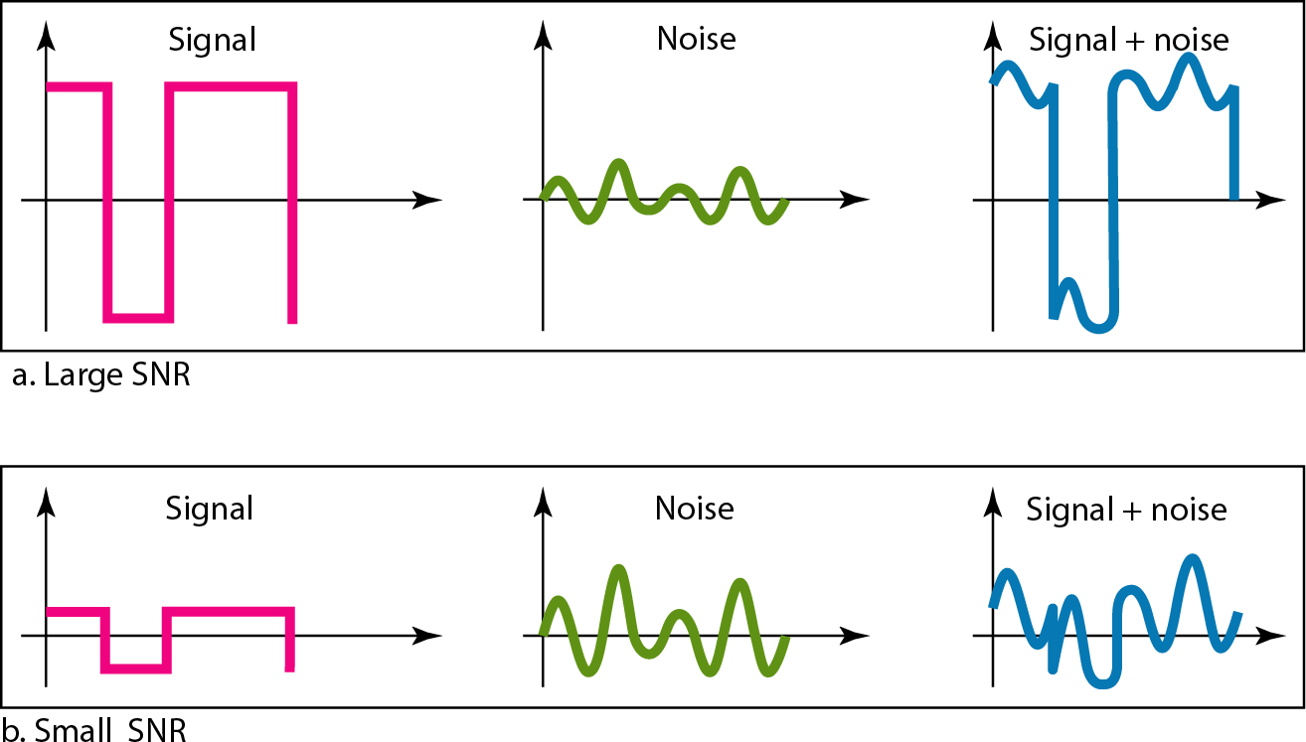
Figure 3.30 Two cases of SNR: a high SNR and a low SNR

Slide 46
Game 3: SNR Showdown 🎤
Your signal's trying to shout over a noisy crowd. Can it win?
Which ratio tells us how loud the signal is compared to the noise?
A. Bit Rate
B. Modulation Index
C. dBm
D. SNR (Signal-to-Noise Ratio)
Notes:
Correct Answer: D. SNR (Signal-to-Noise Ratio)
Justification:
SNR compares signal power to noise power. A higher SNR means your signal can 'shout' better in a noisy room.

